Slide 1
My project
Aya Ibrahim Al-Mahasneh

Slide 2
My project idea
My project idea is focused on identifying fake news on social media. While exploring various algorithms for this task, I had an idea to compare them based on metrics such as accuracy, precision, recall, and training time. By considering these factors, I aim to determine the algorithm that performs the best in terms of its ability to accurately identify fake news while considering the efficiency of training.

Slide 3
Libraries
Panda
Python's strong Pandas package offers capabilities for manipulating and analyzing data. It is frequently employed in data science initiatives, such as those that aim to detect fake news on social media. Pandas provides adaptable data structures, such DataFrames, that make dealing and modifying data simple. It is crucial for activities like importing and organizing data gathered from social media networks since it offers functionality for data cleansing, preprocessing, filtering, and merging. Furthermore, Pandas provides effective feature engineering and data exploration, helping the creation of precise and fast false news detection algorithms.

Slide 4
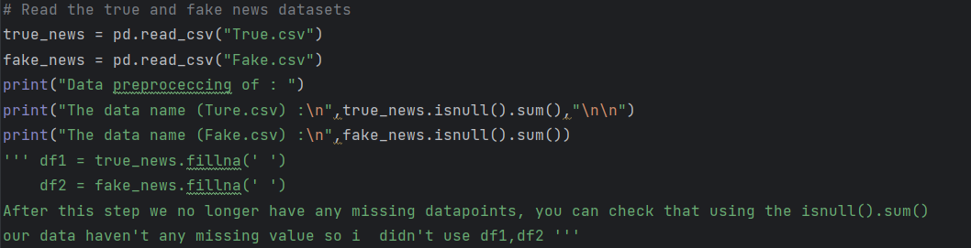
Pre processing and read data

Slide 5
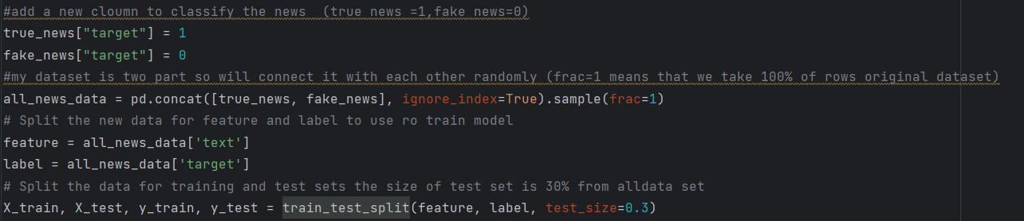
Adding a new column to use it in training my model
To combine the two parts of my dataset, I will merge them randomly using (concat), (frac =1)which means that I will include 100% of the rows from the original dataset.
I have divided my new dataset into a test dataset and a training dataset, with the test dataset comprising 30% of the total data.

Slide 6
Libraries
Scikit-learn (sklearn)
Scikit-learn is a popular Python package for machine learning. For a variety of tasks, including as classification, regression, clustering, and model assessment, it provides an extensive set of tools and techniques. Sklearn offers a large selection of machine learning algorithms that may be used to solve the issue of spotting false news. These algorithms include, among others, naive Bayes, support vector machines (SVM), random forests, and decision trees. A faster method for developing and assessing false news detection models is made possible by Sklearn's additional utilities for data preparation, feature selection, and model assessment.

Slide 7
scikit-learn
The TfidfVectorizer class is part of the scikit-learn library and is used for converting a collection of raw documents into a numerical representation suitable for machine learning algorithms. TF-IDF Vectorizer: TF-IDF stands for "Term Frequency-Inverse Document Frequency." It is a technique used to convert text documents into numerical vectors, which can be understood and processed by machine learning algorithms. The TF-IDF vectorizer calculates the importance of a term in a document relative to its occurrence in the entire corpus of documents. It assigns higher weights to terms that appear frequently in a specific document but infrequently across the entire corpus.

Slide 8
Sklearn
MultinomialNB
Multinomial Naive Bayes (MultinomialNB): Based on Bayes' theorem, Naive Bayes is a probabilistic classifier. For classification applications where the features are discrete, such as word counts in text classification, the Multinomial Naive Bayes classifier is particularly created. It is assumed that, given the class, the characteristics are conditionally independent. Given the TF-IDF vector representation of the input text, it determines the probabilities of each class in the case of text classification.

Slide 9
sklearn.pipeline
make_pipeline: It is a function from the sklearn.pipeline module that helps create a pipeline by sequentially applying a series of transformations followed by a final estimator. In this case, the pipeline consists of the TF-IDF vectorizer as the first step and the Multinomial Naive Bayes classifier as the final estimator
The initial alteration of the data is carried out by the pipeline's first estimator usually, it preprocesses or extracts features from the supplied data.
The last part of the pipeline, the final estimator, makes the last classification or prediction applies the real learning algorithm to the converted data from the earlier phases.

Slide 10
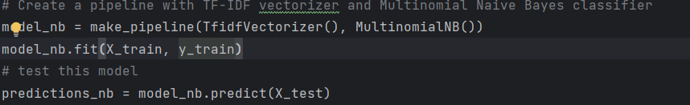
model_nb.fit(X_train, y_train): It learns the patterns and relationships between the features and labels in the training data.
predictions_nb = model_nb.predict(X_test): Once the model is trained, this line of code uses the trained model to predict the labels for the test dataset (X_test).

Slide 11
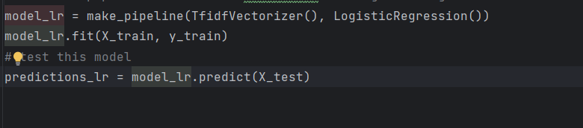
LogisticRegression class from scikit-learn.
It represents a logistic regression classifier, which is a popular algorithm for binary classification.

Slide 12
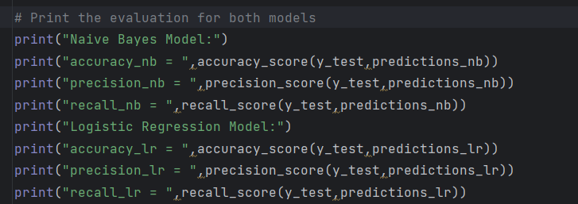
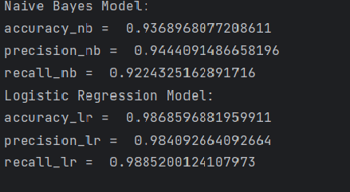

Slide 13
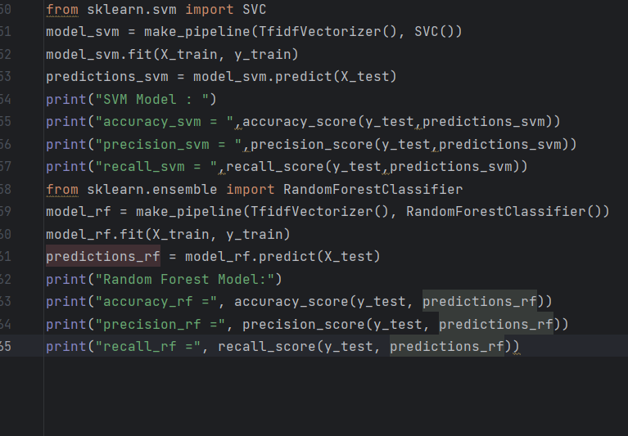
Try with svm and random forest

